Slide 1
ECE5578 Multimedia Communication: Homework 2 Spring 2020
By Matthew Kayrish

Slide 2
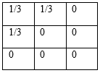
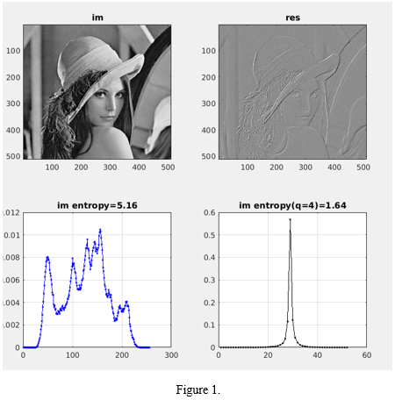
Homework 2: Problem 1 – Introduction

Slide 3
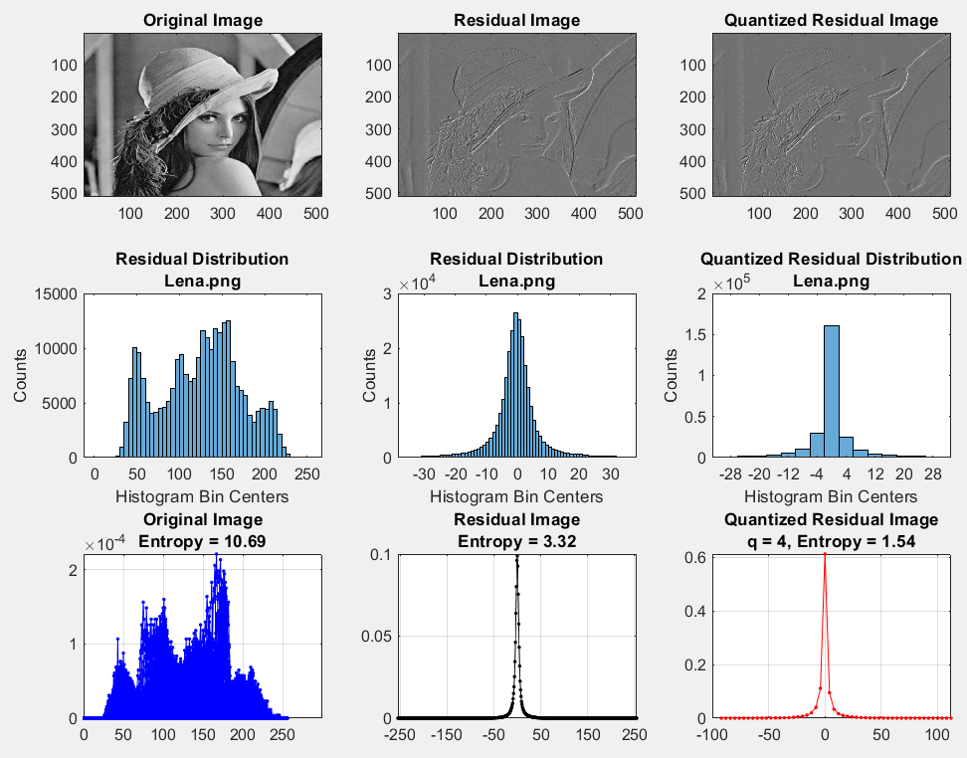
Homework 2: Problem 1 – Support Work

Slide 4
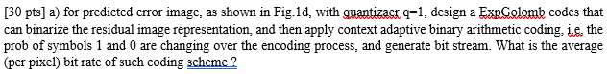
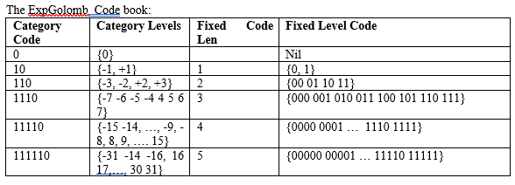
Homework 2: Problem 1.a

Slide 5
Homework 2: Problem 1.a
TASKS:
Calculate Error Image using a Quantizer (q=1).
Design an Exponential Golomb Code.
Binarize the Residual Image.
Apply Context Adaptive Binary Arithmetic Coding to Estimate the Probabilities of ‘0’ and ‘1’.
Generate Bit Stream.
Calculate the Average Bit Rate.

Slide 6
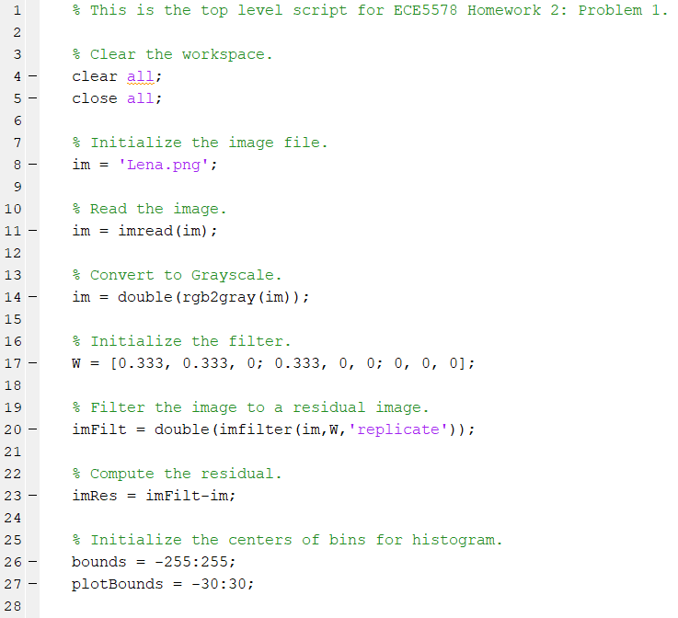
Problem 1.a – Main Software Script
Problem 1.a – Task 1 Activity

Slide 7
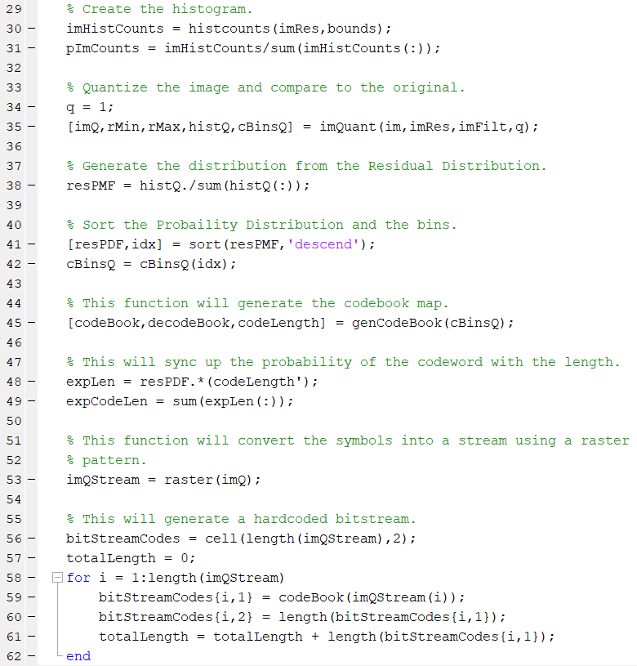
Problem 1.a – Main Software Script
Problem 1.a - Task 1 Activity
Also, Problem 1.b Function
Custom Function ‘imQuant’.
Used for Problem 1.b.
Problem 1.a – Task 2 Activity
Custom Function ‘genCodeBook’.
Used for Generate Binary Codes.
Calculates Expected Codeword
Length
Problem 1.a – Task 3 Activity
Custom Function ‘raster’.
Used to create a Pixel Stream
in Zig-Zag Pattern.
Problem 1.a – Task 3 Activity

Slide 8
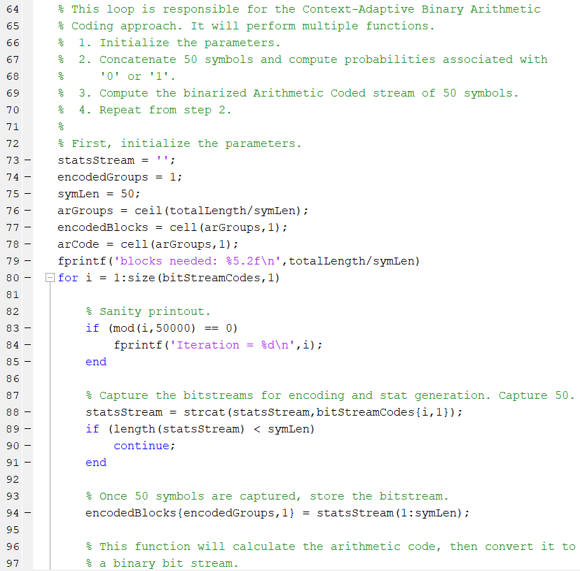
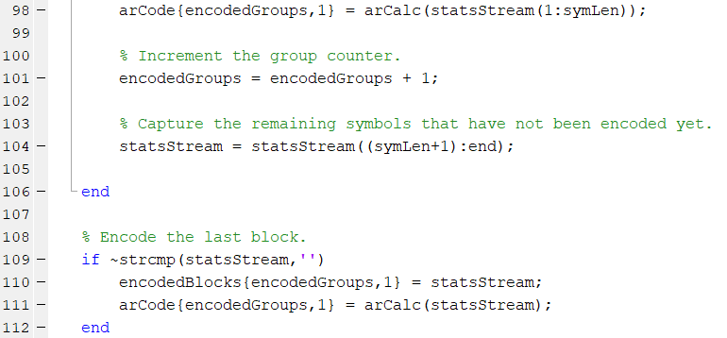
Problem 1.a – Main Software Script
Problem 1.a – Includes Task 4 & 5
Activities
Problem 1.a – Tasks 4 & 5 Activities
Custom Function ‘arCalc’.
Encodes Bitstreams using
Arithmetic Coding.

Slide 9
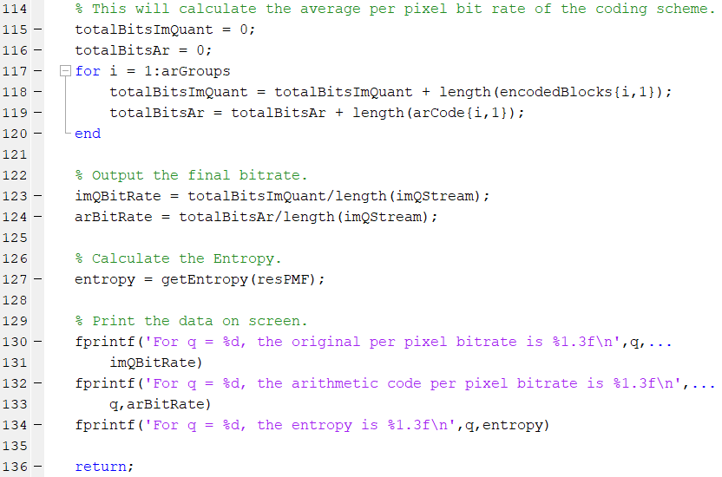
Problem 1.a – Main Software Script
Problem 1.a – Task 6 Activity
Print the Bitrate.

Slide 10
Problem 1.a – Custom Matlab Functions
imQuant
getEntropy
genCodeBook
expGolombEncoder
raster
updatePixel
arCalc
arEncode
Problem 1.b
Problem 1.a – Task 2
Problem 1.a – Task 3
Problem 1.a – Task 4 & 5

Slide 11

Problem 1.a – Task 1: Calculate Error Image using a Quantizer (q=1)

Slide 12
Problem 1.a – Task 2: Design an Exponential Golomb Code
THE FORMAT PROVIDED WITH THE HW2.DOCX FILE WORKS NICELY!

Slide 13
Problem 1.a – Task 2: Design an Exponential Golomb Code
For Lena, with a quantizer of q =1:
Minimum Residual = -93
Maximum Residual = 114
Maximum Occurrence: r = 0 with 51607 occurrences, more than 2x the next highest.
Unary Code | # Values in Group | Values in Group | Unary Code Length | Value Code Length | Total Code Length | Value Codes
0 | 1 | {0} | 1 | 0 | 1 | N/A
10 | 2 | {-1,1} | 2 | 1 | 3 | {0,1}
110 | 4 | {-3,-2,2,3} | 3 | 2 | 5 | {00,01,10,11}
1110 | 8 | {-7 to -4, 4 to 7} | 4 | 3 | 7 | {000,001,…,110,111}
11110 | 16 | {-15 to -8, 8 to 15} | 5 | 4 | 9 | {0000,0001,…,1110,1111}
111110 | 32 | {-31 to -16, 16 to 32} | 6 | 5 | 11 | {00000,00001,… …,11110,11111}
1111110 | 64 | {-63 to -32, 32 to 63} | 7 | 6 | 13 | {000000,000001,… …,111110,111111}
11111110 | 128 | {-93 to -64, 64 to 114} | 8 | 7 | 15 | {0000000,0000001,… …,1111110,1111111}

Slide 14
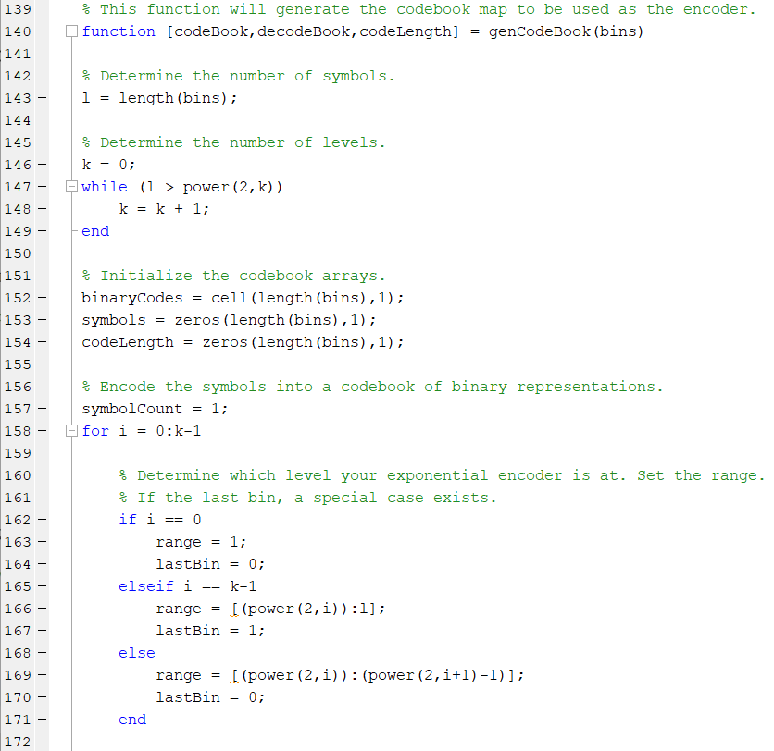
Problem 1.a – Task 2: Design an Exponential Golomb Code

Slide 15
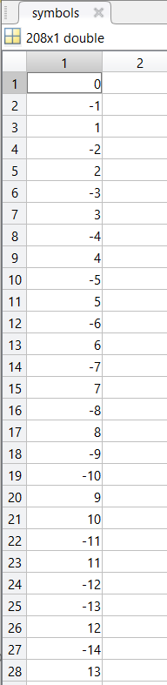
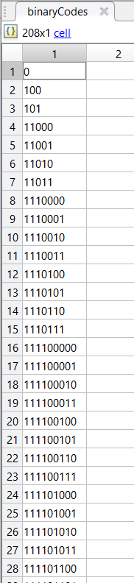
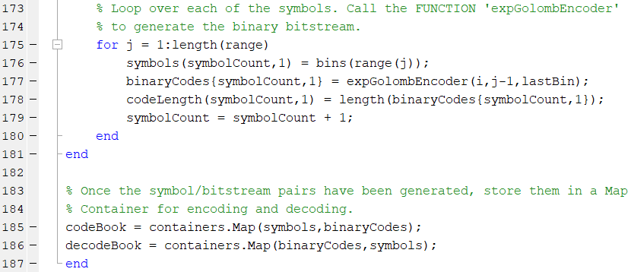
Problem 1.a – Task 2: Design an Exponential Golomb Code

Slide 16
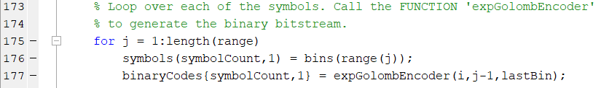
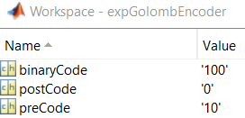
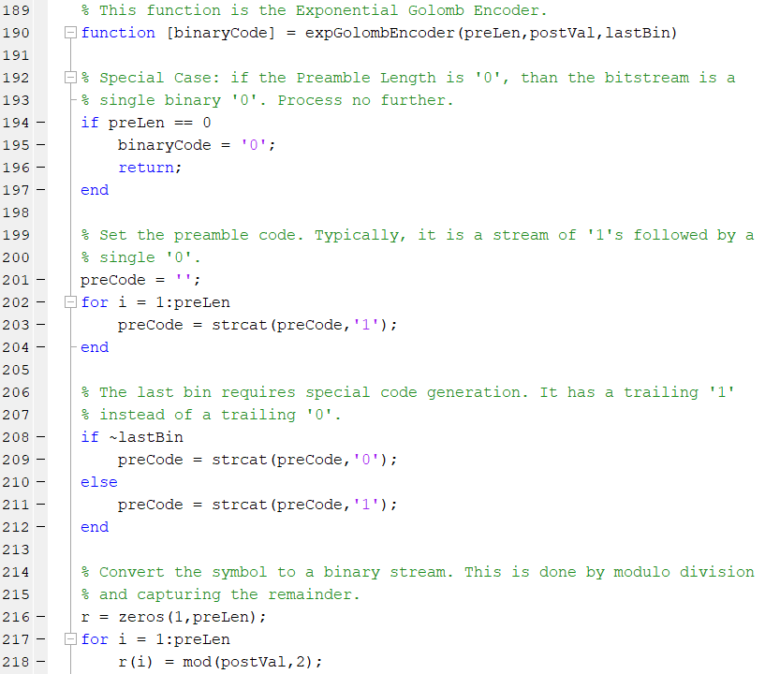
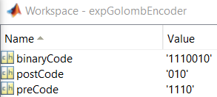
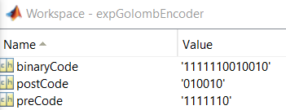
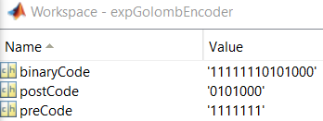
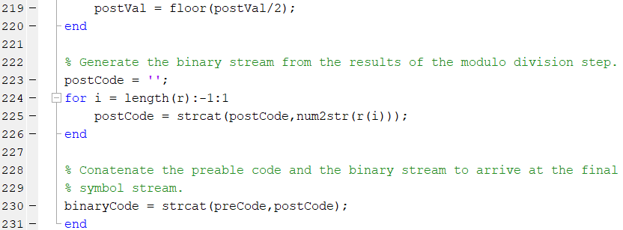
Problem 1.a – Task 2: Design an Exponential Golomb Code

Slide 17
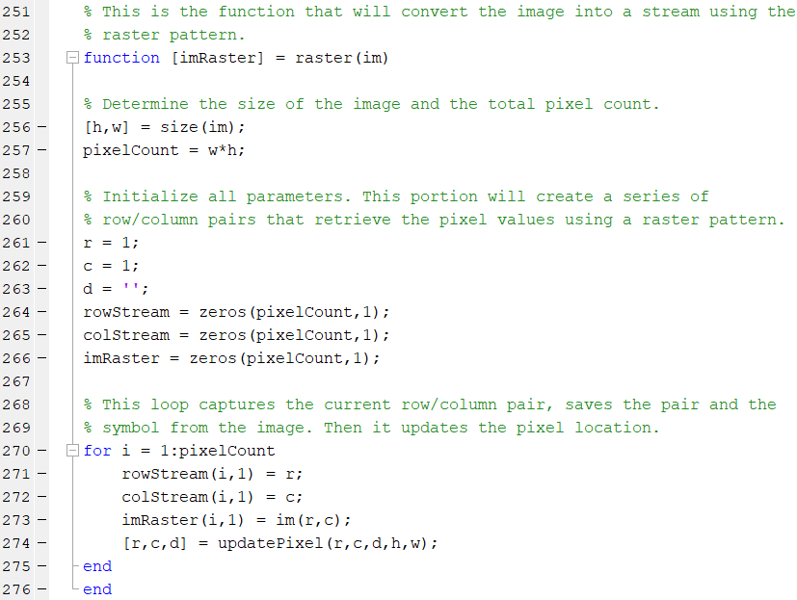
Problem 1.a – Task 3: Binarize the Residual Image
Sweep over the pixels. This is done by the updatePixel Function.

Slide 18
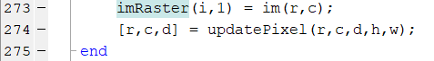
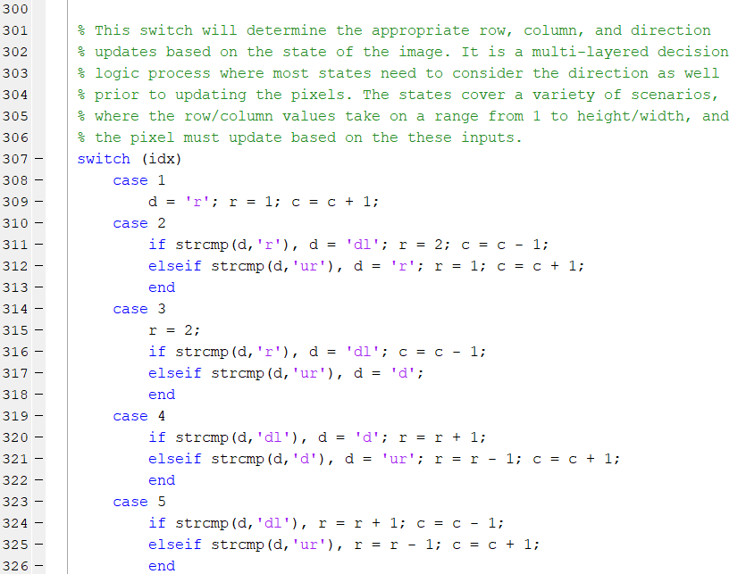
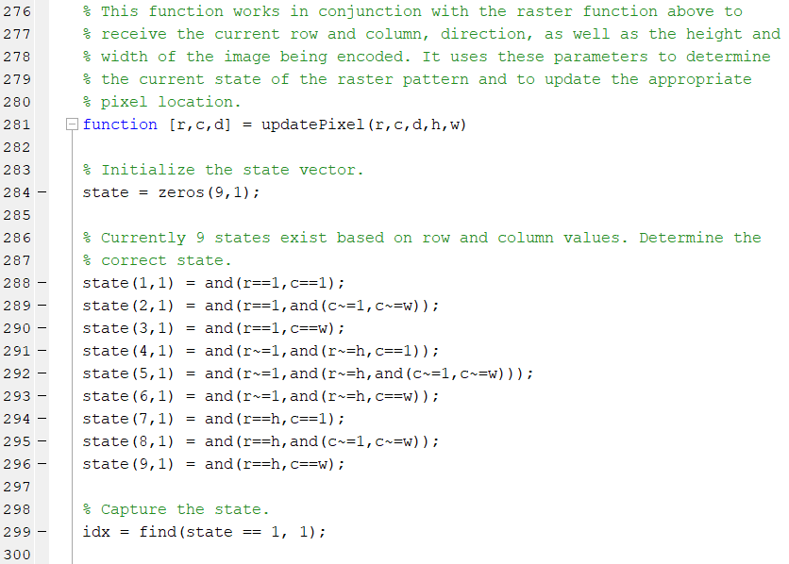
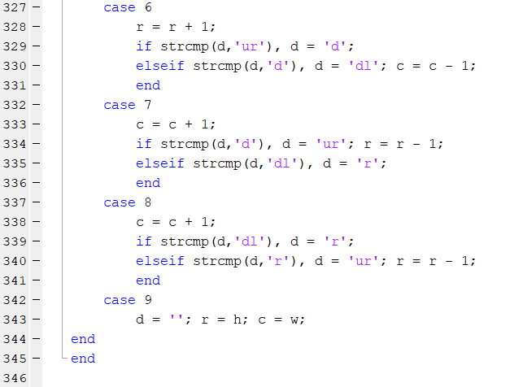
Problem 1.a – Task 3: Binarize the Residual Image

Slide 19
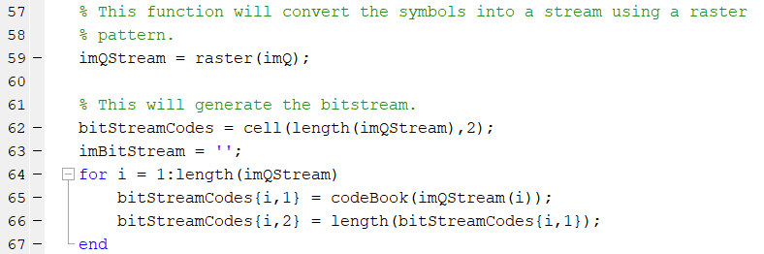
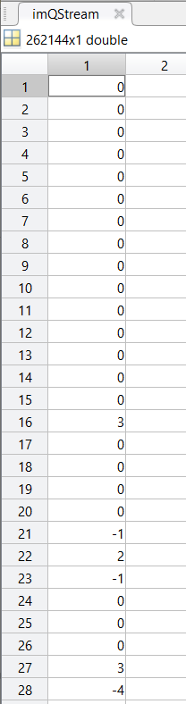
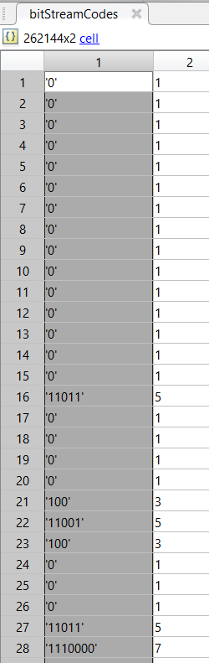
Problem 1.a – Task 3: Binarize the Residual Image
Symbols Corresponding to Bitstream Codes!

Slide 20
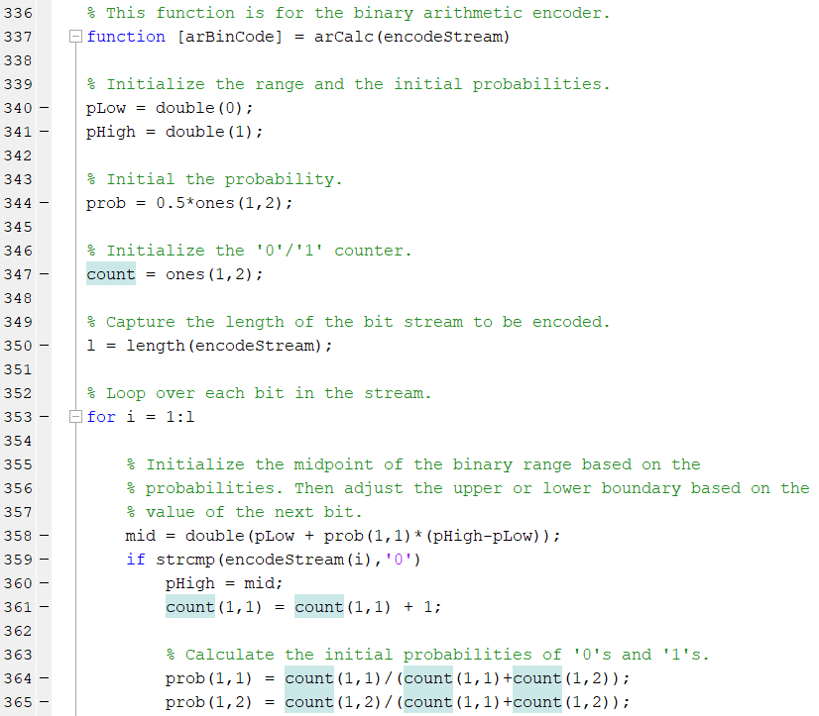
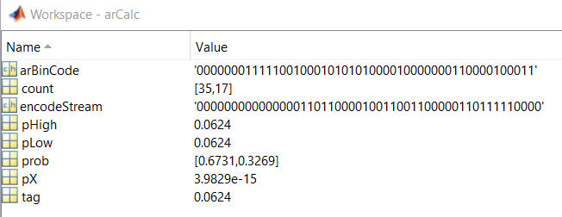
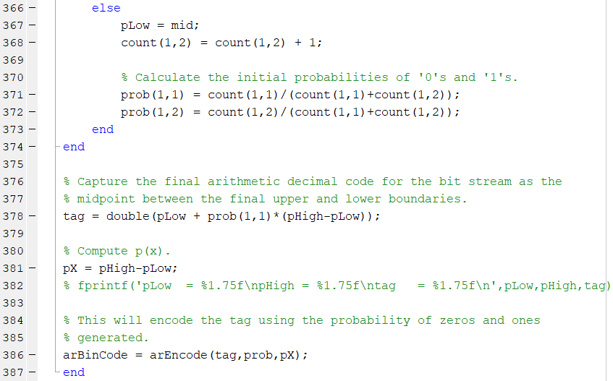
Problem 1.a – Task 4: Apply Context Adaptive Binary Arithmetic Coding to Estimate the Probabilities of ‘0’ and ‘1’
Custom Function: ‘arCalc’
Arithmetic Binary Stream:
- 48 symbols, but changes every block
Encode 50 symbols
Probability of ‘0’ and ‘1’
Tag Value
Custom Function: ‘arEncode’

Slide 21
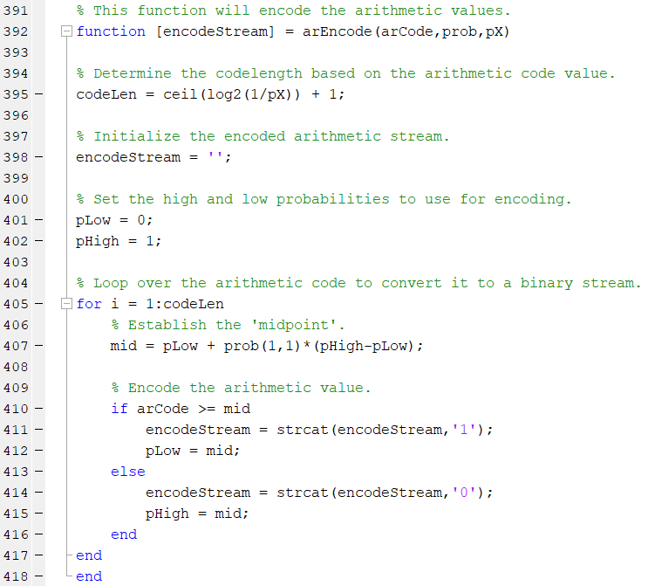
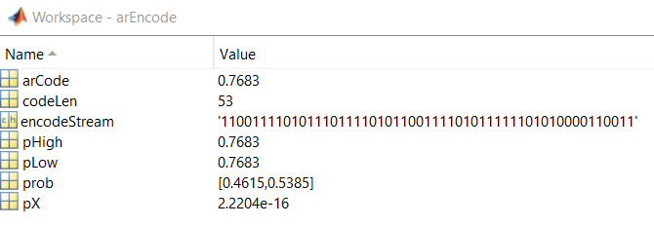
Problem 1.a – Task 4: Apply Context Adaptive Binary Arithmetic Coding to Estimate the Probabilities of ‘0’ and ‘1’
Arithmetic Value & Binary Stream
Probability of ‘0’ and ‘1’

Slide 22
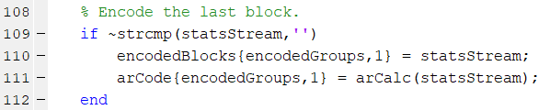
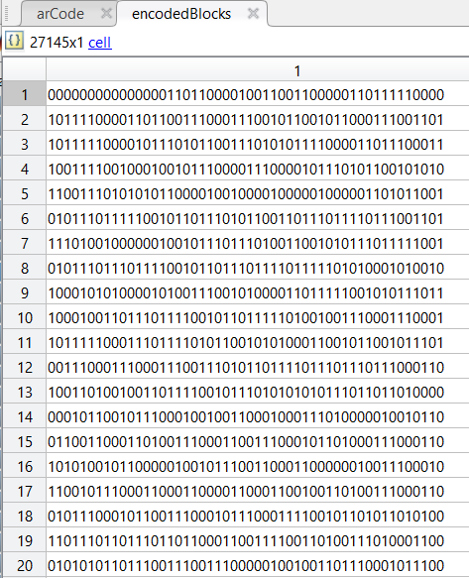
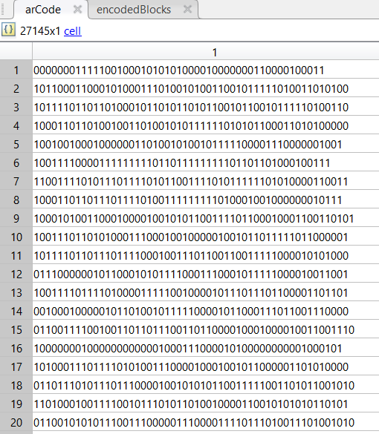
Problem 1.a – Task 5: Generate a Bitstream
Original Block vs Arithmetic Encoded Block (q = 1)

Slide 23
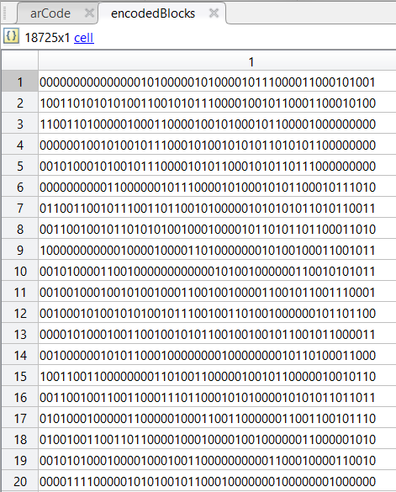
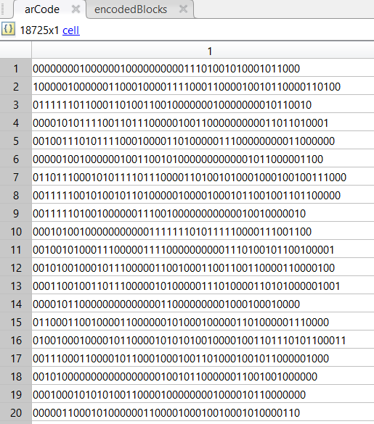
Problem 1.a – Task 5: Generate a Bitstream
Original Block vs Arithmetic Encoded Block (q = 2)

Slide 24
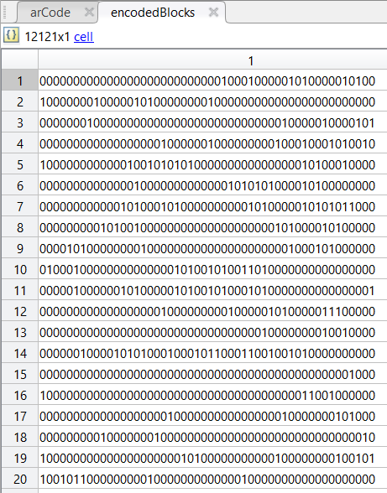
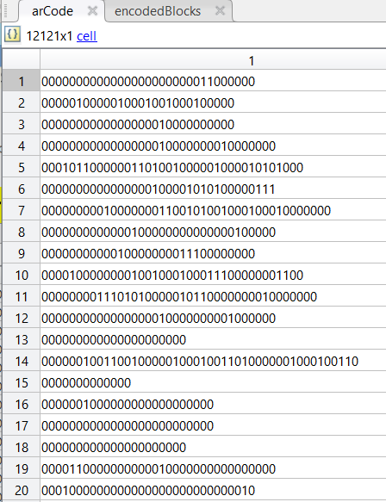
Problem 1.a – Task 5: Generate a Bitstream
Original Block vs Arithmetic Encoded Block (q = 4)

Slide 25
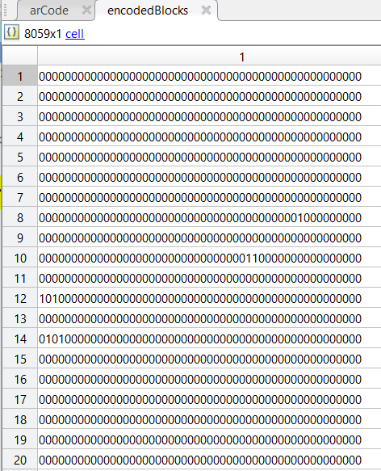
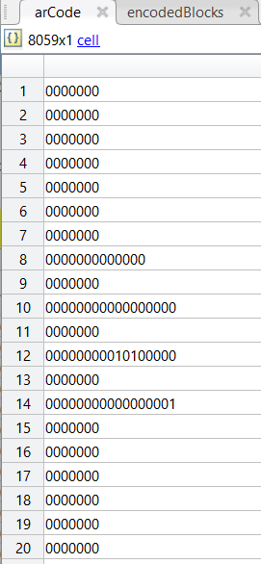
Problem 1.a – Task 5: Generate a Bitstream
Original Block vs Arithmetic Encoded Block (q = 8)

Slide 26
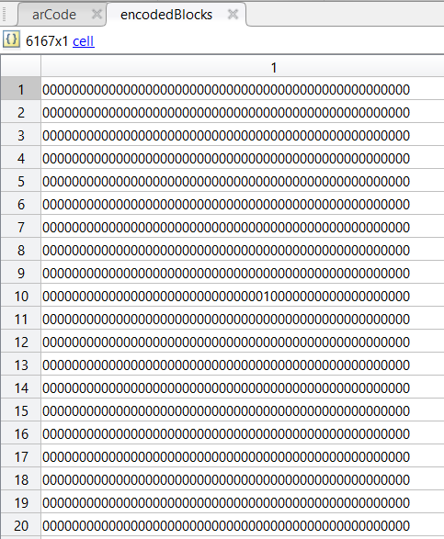
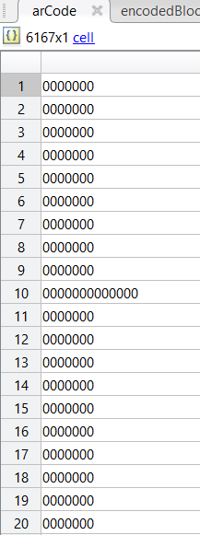
Problem 1.a – Task 5: Generate a Bitstream
Original Block vs Arithmetic Encoded Block (q = 16)

Slide 27
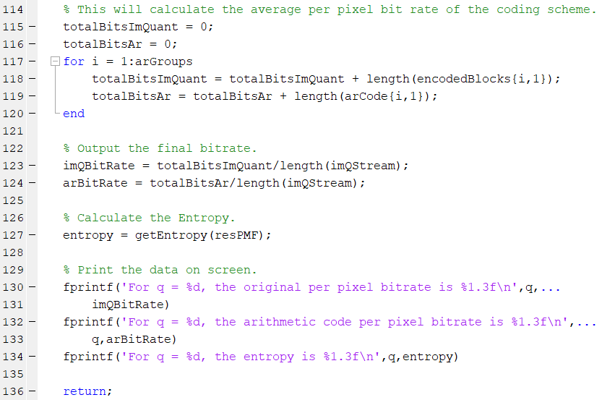
Problem 1.a – Task 5: Calculate the Average Bit Rate
Operating Parameters:
Total Symbols: 262114
Unique Symbols/Codewords: 208
50 Symbols coded for each Arithmetic Code.
Quantization | 1 | 2 | 4 | 8 | 16
Original Per Pixel Bitrate | 5.18 | 3.57 | 2.31 | 1.54 | 1.18
Encoded Per Pixel Bitrate | 5.39 | 3.72 | 2.24 | 1.14 | 0.542
Entropy | 3.18 | 2.37 | 1.54 | 0.82 | 0.36

Slide 28
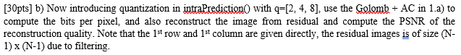
Homework 2: Problem 1 Part (b)
TASKS:
Rely on the code from Problem 1.a.
For a Quantization level of q = 2, 4, and 8, do the following:
Compute the per pixel bitrate.
Reconstruct the image from the Quantized Residual Image.
Compute the PSNR.

Slide 29
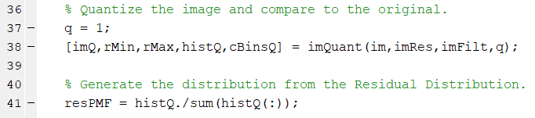
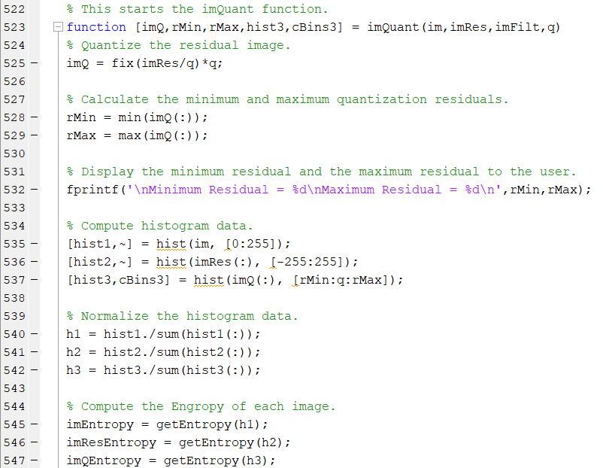
Problem 1.b – Task 1: Rely on the Code from Problem 1.a
Problem 1.b is implemented in part as a single function ‘imQuant’ in Problem 1.a. The code is
robust enough to handle all of the quantization levels identified in Problem 1.b.
Problem 1.b – Main Software Script

Slide 30
Problem 1.b – Main Software Script
Image Quantizer
Find Min and Max Residuals
Compute Histograms for
Original Image, Residual Image,
And Quantized Image.
Normalize the Histogram data
Compute the Entropy for
Original Image, Residual Image,
And Quantized Image.

Slide 31
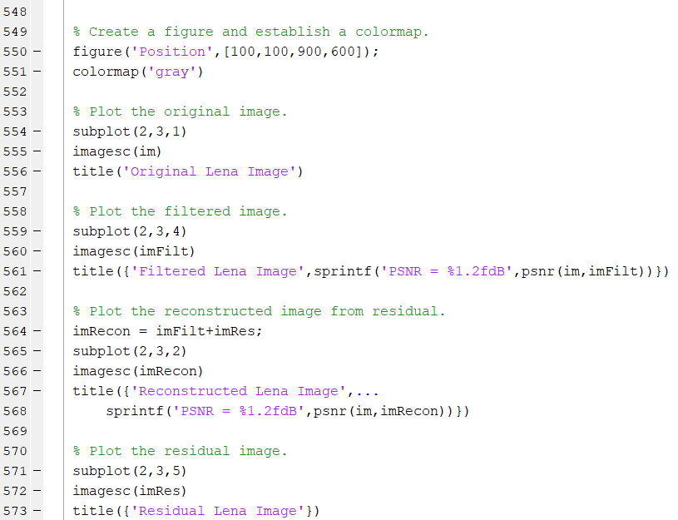

Problem 1.b – Main Software Script
Generate figures for Part 1.b

Slide 32

Problem 1.b – Main Software Script
Generate figures for Part 1.b

Slide 33

Problem 1.b – Main Software Script
Generate figures for Part 1.b

Slide 34


Problem 1.b – Main Software Script

Slide 35

Problem 1.b – Task 2: For quantization of q = 0 (no quantization), A. Compute the per pixel bitrate, B. Reconstruct from the quantized image, C. Compute the PSNR.

Slide 36

Problem 1.b – Task 2: For quantization of q = 0 (no quantization), A. Compute the per pixel bitrate, B. Reconstruct from the quantized image, C. Compute the PSNR.

Slide 37

Problem 1.b – Task 2: For quantization of q = 1, A. Compute the per pixel bitrate, B. Reconstruct from the quantized image, C. Compute the PSNR.

Slide 38

Problem 1.b – Task 2: For quantization of q = 1, A. Compute the per pixel bitrate, B. Reconstruct from the quantized image, C. Compute the PSNR.

Slide 39

Problem 1.b – Task 2: For quantization of q = 2, A. Compute the per pixel bitrate, B. Reconstruct from the quantized image, C. Compute the PSNR.

Slide 40

Problem 1.b – Task 2: For quantization of q = 2, A. Compute the per pixel bitrate, B. Reconstruct from the quantized image, C. Compute the PSNR.

Slide 41

Problem 1.b – Task 2: For quantization of q = 4, A. Compute the per pixel bitrate, B. Reconstruct from the quantized image, C. Compute the PSNR.

Slide 42

Problem 1.b – Task 2: For quantization of q = 4, A. Compute the per pixel bitrate, B. Reconstruct from the quantized image, C. Compute the PSNR.

Slide 43

Problem 1.b – Task 2: For quantization of q = 8, A. Compute the per pixel bitrate, B. Reconstruct from the quantized image, C. Compute the PSNR.

Slide 44

Problem 1.b – Task 2: For quantization of q = 8, A. Compute the per pixel bitrate, B. Reconstruct from the quantized image, C. Compute the PSNR.

Slide 45

Problem 1.b – Task 2: For quantization of q = 16, A. Compute the per pixel bitrate, B. Reconstruct from the quantized image, C. Compute the PSNR.

Slide 46

Problem 1.b – Task 2: For quantization of q = 16, A. Compute the per pixel bitrate, B. Reconstruct from the quantized image, C. Compute the PSNR.

Slide 47
Problem 1.b – Task 2: Results for quantization of q = [1, 2, 4, 8, 16]
Quantization | 1 | 2 | 4 | 8 | 16
Per Pixel Bitrate | 5.18 | 3.57 | 2.31 | 1.54 | 1.18
PSNR (dB) | 25.43 | 25.30 | 25.06 | 24.59 | 23.80
Entropy | 3.18 | 2.37 | 1.54 | 0.82 | 0.36

Slide 48



Homework 2: Problem 2

Slide 49
Homework 2: Problem 2
TASKS:
Binarize the Image.
Design a Coding Scheme.
Apply Context Aware Binary Arithmetic Coding to Estimate the Probabilities of ‘0’ and ‘1’.
Generate Bit Stream.
Calculate the Average Bit Rate.
NOTE: Many of the Tasks that are repeated from Problem 1.a have been omitted.

Slide 50

Problem 2 – Main Software Script
Problem 2 – Task 1 Activity
Custom Function ‘biLevelIm’
Problem 2 – Task 2 Activity
Custom Function ‘genCodeBook’

Slide 51


Problem 2 – Main Software Script
Problem 2 – Includes Task 3 & 4

Slide 52

Problem 2 – Main Software Script
Problem 2 – Includes Task 3 & 4
Custom Function ‘biArEncode’.
Encodes Bitstreams using
Arithmetic Coding.

Slide 53

Problem 2 – Main Software Script
Problem 2 – Includes Task 5
Custom Function ‘getEntropy’.
Computes the lower limit on
Information per bit.

Slide 54
Problem 2 – Custom Matlab Functions
biLevelIm
genCodeBook
biArEncode
stateAnalysis
statsInit
arEncode
getEntropy
Problem 2 – Task 1
Problem 2 – Task 2
Problem 2 – Task 3 & 4

Slide 55



Problem 2 – Task 1: Binarize the Image.
After Binarization, the Image consists strictly of
Black and White Pixels only. This greatly simplifies
the encoding to a very simplistic ‘0’ or ‘1’ scheme.

Slide 56



Problem 2 – Task 2: Design a Coding Scheme

Slide 57

Problem 2 – Task 3: Apply Context Aware Binary Arithmetic Coding to Estimate the Probabilities of ‘0’ and ‘1’
Determine the ‘Context’ for Context-Aware.

Slide 58



Problem 2 – Task 3: Apply Context Aware Binary Arithmetic Coding to Estimate the Probabilities of ‘0’ and ‘1’
This is the set of probabilities for each symbol
Prior to the Context Aware Binary Arithmetic
Coding Algorithm.

Slide 59


Problem 2 – Task 3: Apply Context Aware Binary Arithmetic Coding to Estimate the Probabilities of ‘0’ and ‘1’
8 States
This is the set of probabilities for each symbol
Prior to the Context Aware Binary Arithmetic
Coding Algorithm.

Slide 60


Problem 2 – Task 3: Apply Context Aware Binary Arithmetic Coding to Estimate the Probabilities of ‘0’ and ‘1’
This is the set of probabilities for each symbol
after the Context Aware Binary Arithmetic
Coding Algorithm.

Slide 61
Problem 2 – Task 3: Apply Context Aware Binary Arithmetic Coding to Estimate the Probabilities of ‘0’ and ‘1’
Determine the ‘Context’ for Context-Aware.
8 States

Slide 62


Problem 2 – Task 3: Apply Context Aware Binary Arithmetic Coding to Estimate the Probabilities of ‘0’ and ‘1’

Slide 63



Problem 2 – Task 4: Generate Bit Stream

Slide 64

Problem 2 – Task 4: Generate Bit Stream
Arithmetic Encoded Bit Stream
Original Bit Stream
Arithmetic Value

Slide 65

Problem 2 – Task 4: Generate Bit Stream
Encoding 50 Symbols per Codeword
imBitStreams = ‘Original Bit Streams’
arCode = ‘Arithmetic Encoded Bit Streams’

Slide 66


Problem 2 – Task 4: Generate Bit Stream
Original Bit Stream vs. Encoded Bit Stream

Slide 67

Problem 2 – Task 5: Calculate the Average Bitrate
Original Bitrate
Arithmetic Encoded Bitrate
Compute the Entropy
Print the Results

Slide 68


Problem 2 – Task 5: Calculate the Average Bitrate

Slide 69
Problem 2 – Task 5: Calculate the Average Bitrate
Operating Parameters:
Total Symbols: 262114
Unique Symbols/Codewords: 2
Expected Code Length: 1
50 Symbols coded for each Arithmetic Code.
For a binarized image:
The original per pixel bitrate is 1
The arithmetic encoded per pixel bitrate is 0.198
The entropy is 0.693.

Slide 70
Homework 2 – Summary & Conclusion
Work Performed:
Evaluated the change in image quality and per pixel bitrate vs quantization level.
Assessed the performance changes of step 1, which is shown below.
Quantization | 1 | 2 | 4 | 8 | 16 | Binary
Per Pixel Bitrate | 5.18 | 3.57 | 2.31 | 1.54 | 1.18 | 1
PSNR (dB) | 25.43 | 25.30 | 25.06 | 24.59 | 23.80 | N/A
Entropy | 3.18 | 2.37 | 1.54 | 0.82 | 0.36 | 0.69
Conclusion:
Quantization effectively decreases the Per Pixel Bitrate without sacrificing much quality.
Entire bitstreams can be encoded in relatively short decimal streams using arithmetic
coding.

